Slide 1
Virtue ethics
Lesson 4

Slide 2
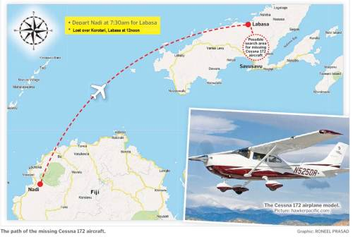
Search for the missing Cessna 172 aircraft

Slide 3
Pacific Flying School Cessna 172 crewed by trainee pilot Merelesita Lutu, 21 and flying instructor Iliesa Tawalo were last heard from at noon on Monday (26 Feb., 2018).
Divisional Police Commander North SSP Verani Nakauyaca said that the search had no result, but that they would resume early tomorrow morning.

Slide 4
3 search teams
Twenty-nine military and police personnel together with ten villagers from Doguru comprise the three teams leading the ground search in the area.
http://www.fbc.com.fj/fiji/60405/aerial-search-for-missing-aircraft-resumes

Slide 5
Rescuing
Why did the 3 rescue teams take part in the rescue?
How does a deontologist justify this moral action?
How does a utilitarian justify this moral action?

Slide 6
Utilitarianism
Deontology
Focused on moral actions
Moral principle
Universal
‘Maximize the happiness and minimize the pain and suffering for the greatest number of people.’
Rational
Consequentialist
Whether an act or moral principle (or rule) is justified depends on whether it brings the best possible outcome (most happiness, least pain) to the greatest number of people.
Focused on moral actions
Moral principle (categorical imperative)
Universal
‘Act only in accordance with the maxim through which you can at the same time will that it become a universal law.’
‘Treat people as an end, not merely as a means.’
Rational
Non-consequentialist
Any correct moral action should fulfil a moral principle (that specifies our moral duties, informing us what we ought to do).

Slide 7
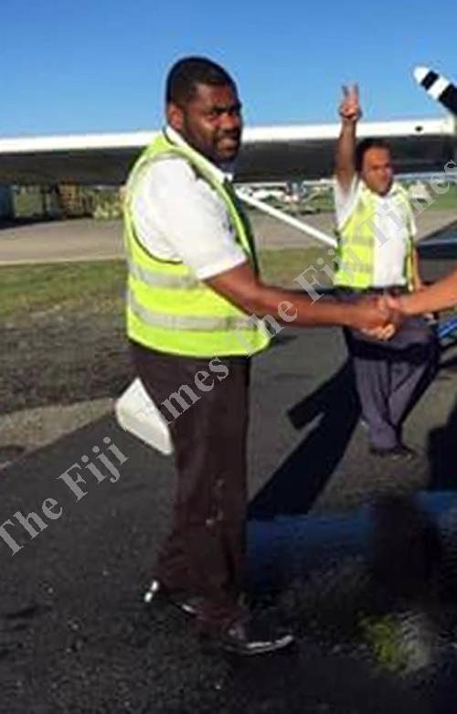
Iliesa Tawalo

Slide 8
PFS managing director and owner Tim Joyce said Mr Tawalo volunteered to sit in while a trainee conducted the flight.
"Iliesa wasn't even supposed to be on that flight, he was only sitting in as a safety pilot," said Mr Joyce.
"That's just the kind of person he is.
"Iliesa is not only an employee, he is a very valued member of our team.
"He is one of the ones we sponsored and apart from our professional relationship, he is also a very close friend.
"Iliesa always went above and beyond the call of duty in terms of assisting our trainees. He is extremely professional and very experienced as an instructor.
http://www.fijitimes.com/story.aspx?id=436130

Slide 9
Virtues (= good qualities) of Iliesa Tawalo
Enthusiasm
Caring
Helpfulness
Commitment
Devotion
Diligence
Professionalism
…

Slide 10
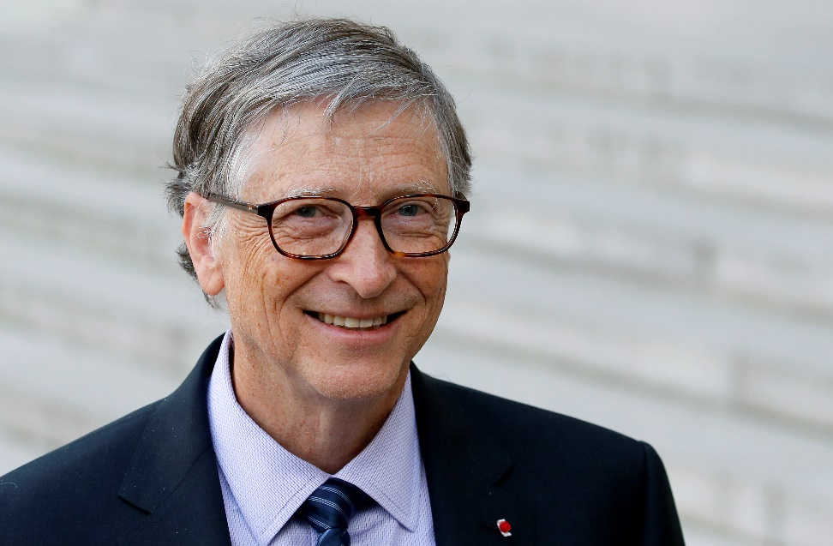
Bill Gates 1955 -
Intelligence, Vision, Passion, Innovation, Confidence, Entrepreneurship
A risk taker, continuous learner, accepts criticisms, learns from failure, never stops asking questions and he has expert power
https://answers.yahoo.com/question/index?qid=20120618164140AAop3uM

Slide 11
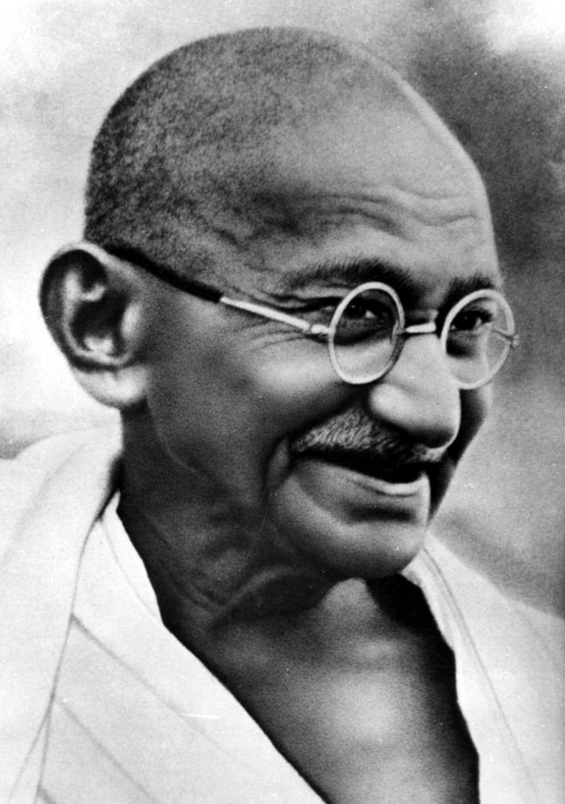
Mahatma Gandhi 1869 – 1948
‘The virtues of patience, self-control, and courage … were absolutely essential to defeat the temptation to retaliate and respond with violence.’
Nicholas F. Gier, ‘Gandhi and the virtue of nonviolence’
http://www.webpages.uidaho.edu/ngier/gandhiVN.htm

Slide 12
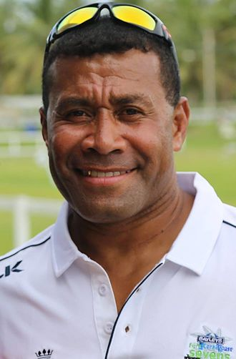
Waisale Tikoisolomoni Serevi 1968-

Slide 13
Examples of virtues
Prudence*
Cautious, caring and being thoughtful for the consequences
Justice
Fortitude
Temperance
Patience
Diligence*
Hardworking + direction (vision)
Humility
Kindness
Chastity
Generosity
Compassion
Perseverance*
Honesty
Integrity*
Fidelity (loyalty, trustworthiness)
Filial piety
Respect owed to one’s parents, senior family members and ancestors
Truthfulness*
Reasonableness*
*Both moral and intellectual

Slide 14
Generosity
Justice
Kindness
Honesty
Compassion
Understanding
Caring
Courage
…
Scientific, artistic, technical, philosophical wisdom
Intellectual responsibility
Love of truth
Imaginativeness
Curiosity
Open-mindedness
…
MORAL VIRTUES
(involving good character and conduct)
INTELLECTUAL VIRTUES

Slide 15
Characteristics of virtues
Excellence
Virtues are good. In contrast, vices are bad.
A settled disposition
(roughly: habit or tendency) to behave in a certain way
Attitudes
Sentiments
Spontaneity
Either intellectual or moral or both
Holistic – forming a (moral) character

Slide 16
Examples of vices
Selfishness
Imprudence (not showing care for the likely results of an action; rash)
Weak sense of responsibility
Lack of moderation (excess, no self-restraint)
Lack of integrity
Lack of caring
Lack of sincerity
Lack of trustworthiness

Slide 17
More examples of vices
Stupidity
Cowardice
lacking in courage, no self-confidence
Lethargy
a lack of energy and enthusiasm
Submissiveness
accepting oppression by others
Foolhardiness
foolishly brave
reckless action in cases where it is inappropriate

Slide 18
Deontological ethics: problem 1
Deontology: Emotions, desires or inclinations should not influence our reason when we make moral judgments or decisions.
Virtue ethics: moral emotions, feelings (e.g. feelings of righteous indignation), dispositions, attitudes, or sentiments should not be neglected.
They do not simply reflect our subjective responses, but inform
our (the agent’s) moral character
the moral implication of a situation.

Slide 19
Deontological ethics: problem 2
Deontology: We should obey the categorical imperative, which is an unconditional and universal moral law.
Virtue ethics: Human lives are very complex. In moral dilemmas, we cannot fulfil some moral principles. Which moral principle should be given priority is dependent on contexts (situations or circumstances).
Some examples:
The taxi driver exceeded the speed limit in order to take a pregnant woman who was in labour to her hospital.
Jane did not inform her mother that her mother had a cancer.

Slide 20
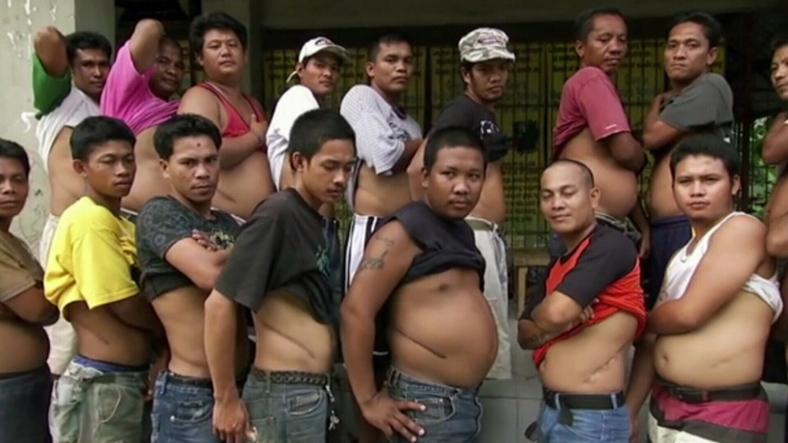

Slide 21
Is selling one’s kidney acceptable?
Deontology: It is against moral law. We should treat our self and others as an end.
Virtue ethics: Basically, it is not merely a matter of fulfilling obligation. We need to ask the following questions:
‘What is likely to be the situation of a person who would want to sell their kidney?
To whom might they wish to sell?
How much will they be paid?
What safeguards are in place to protect the health of the donor and the recipient?
What are the circumstances of donors and what dependents have they?
Are donors psychologically and emotionally stable?
Have they been subject to any duress?’
http://jme.bmj.com/content/29/5/297.full

Slide 22
Various contexts
The organ donors who are in poor and desperate condition want to survive.
Some donors sold their kidney in order to buy an iPad.
The above contexts of organ trade are very different. Should we consider the contexts or strictly stick to certain (universal and unconditional) moral principles or rules in moral evaluation?

Slide 23
Our affect (sensitivity) contributes to our moral perception.
In general, we have distaste on organ trade – exchanging an irreplaceable part of our body for money.
We feel sad and pity because those who sell their organs are very poor and deprived people.
We are angry with those businessmen who profit from the organs of the underprivileged and oppressed.

Slide 24
The compassionate person’s response
S/he would feel the suffering and misery of the desperate kidney donors. Their social and medical condition, and the social justice in their country, will be taken into consideration.
S/he would also feel the pain and despair for those who suffer from renal failure and desperately want to buy a kidney (and for these patients’ family).

Slide 25
Making a balanced and sensible judgment
‘[S/he] would [try to feel and understand] those needs and using wise judgment to balance her compassion for those in renal failure and the deprived who may be enticed into selling organs.
Having considered the facts, the emotional response, and the motivations of all concerned, she would look for creative solutions that might address the needs of both groups.’
Gardiner, P. 2003. ‘A virtue ethics approach to moral dilemmas in medicine’ in Journal of Medical Ethics, 29: 297–302.
http://jme.bmj.com/content/29/5/297.full

Slide 26
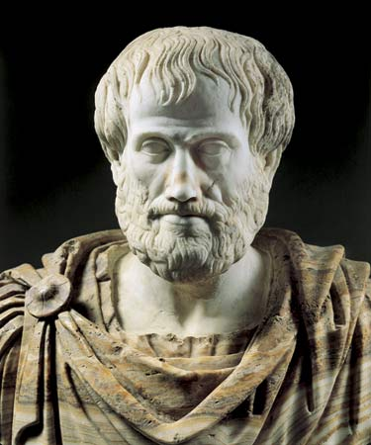
Aristotle

Slide 27
Aristotle’s account of (moral) virtues
Appropriate feelings and dispositions bring about appropriate action.
‘Virtue … is a reliable disposition whereby one reacts in relevant situations with the appropriate feeling — neither excessive nor deficient — and acts in the appropriate way — neither excessively nor deficiently’ (ibid.)
E.g. When listening to the news about a rape case, a person is very angry. We think that the feeling is appropriate. But if another person has the same intense anger when his friend forgot his name, such a feeling is inappropriate.

Slide 28
Golden Mean
Virtues are a point of moderation between two opposite vices (extremes).
Examples:
VICES (defect) | VIRTUES (mean) | VICES (excess)
cowardice | courage or confidence | rashness or recklessness
a lack of sensitivity to one’s own needs | temperance (or self-control) | self-indulgence
bashfulness (shyness) | modesty | vanity

Slide 29
VICES (defect) | VIRTUES (mean) | VICES (excess)
Mean, miserly | Generosity | wastefulness
Diffidence | Confidence | Arrogance
Unfriendliness, unpleasantness | Friendliness | Flattery

Slide 30
The concerns of virtue ethics
Not simply:
What is the right/wrong action?
But:
What is a good life? What does living well mean?
What is a good person?
For Aristotle, the answers should be in terms of ‘eudaimonia’.

Slide 31
Eudaimonia
= happiness, well-being, doing well,
living well
≠ pleasure, fun, utility value
= flourishing (which involves activities,
efforts, thinking, etc.).

Slide 32
Take one more example: abortion
Even though some societies grant women the right to abortion, in exercising this right, in some cases, abortion could be a selfish, childish, stupid, cruel, callous (insensitive, not caring), dishonest, or shallow (not exhibiting serious thought) event.

Slide 33
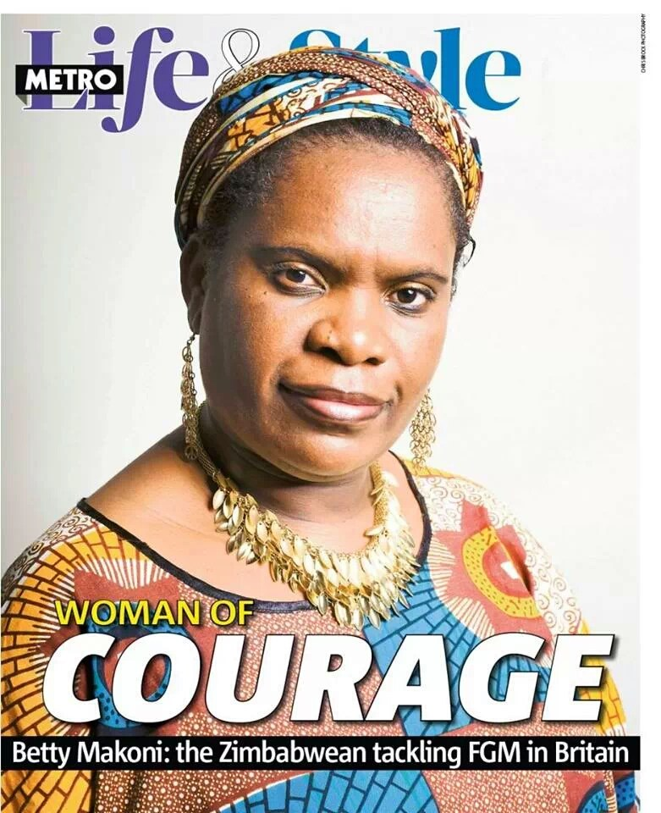
A case: Caring and courage
Betty Makoni, a Zimbabwe native, founded the Girl Child Network to provide a haven for young victims of sexual abuse. Since 2001, the organization has rescued more than 35,000 girls.

Slide 34
Different moral views
Deontology
Betty Makoni’s moral action:
she provided a home for the girls who were sexually abused.
She fulfilled the moral principle: ‘Care for those people in need’.
Moral principles are categorical imperative (unconditional moral command).
She treated those girls as an end.
She fulfilled her obligation (duty, responsibility) as a person.
Utilitarianism
Betty Makoni’s caring action is praiseworthy because it brought about the greatest happiness for the greatest number of people (the 35,000 girls benefitted)
Virtue ethics
Betty Makoni is a caring person; she has a caring moral character.
(She is a wise person as well since she founded the Girl Child Network. It is a very good solution to the sexual-abuse problem.)

